Slide 1
3. The Visual Basic Language
Prof Yousef B.Mahdy

Slide 2
The Message Box
One of the best functions in Visual Basic is the message box. The message box displays a message, optional icon, and selected set of command buttons. The user responds by clicking a button.
The statement form of the message box returns no value (it simply displays the box):
  MsgBox Message, Type, Title
where
  Message Text message to be displayed
  Type Type of message box (discussed in a bit)
  Title Text in title bar of message box
  You have no control over where the message box appears on the screen.

Slide 3
The Message Box
The function form of the message box returns an integer value (corresponding to the button clicked by the user). Example of use (Response is returned value):
  Dim Response as Integer
  Response = MsgBox(Message, Type, Title)
The Type argument is formed by summing four values corresponding to the buttons to display, any icon to show, which button is the default response, and the modality of the message box.

Slide 4
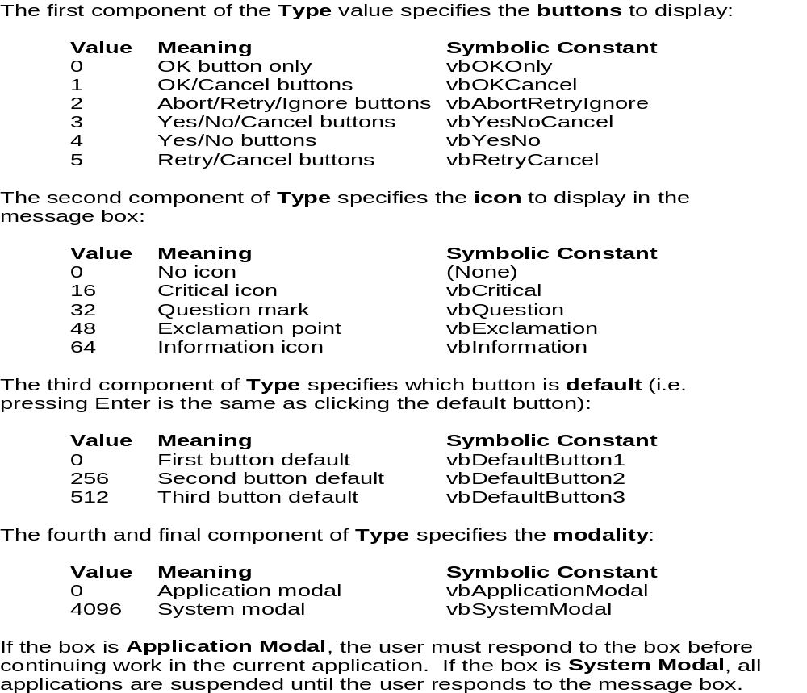
The Message Box

Slide 5
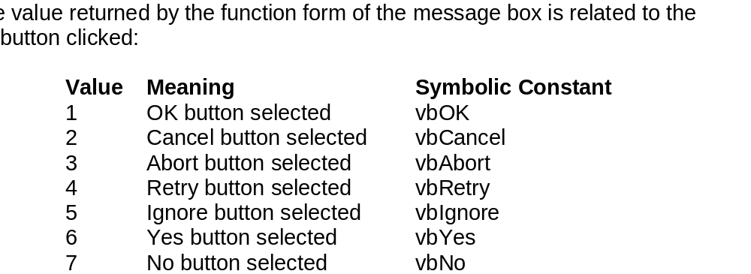
The Message Box

Slide 6
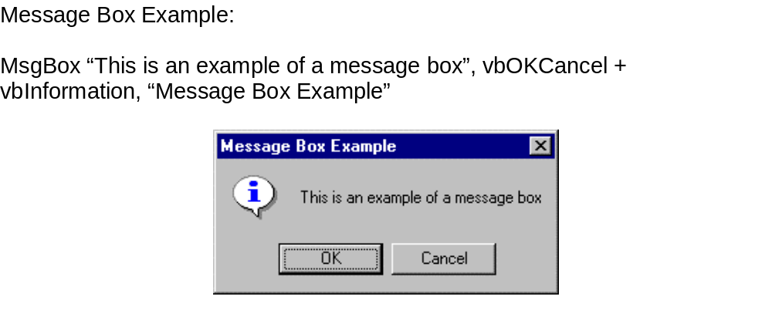
The Message Box

Slide 7
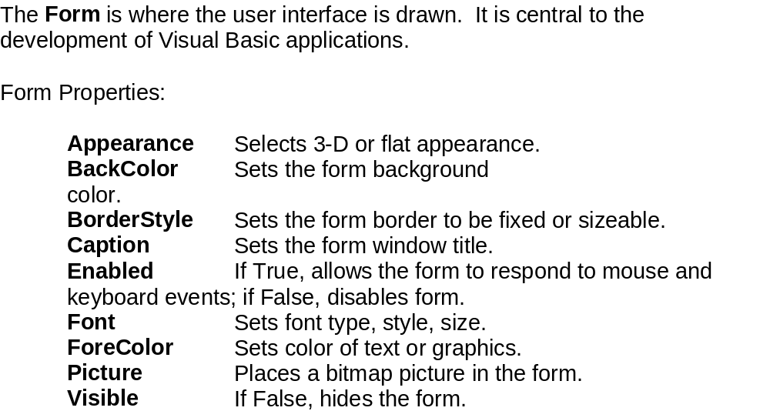
The Form Object

Slide 8
The Form Object
Form Events:
Activate Form_Activate event is triggered when form becomes the active window.
Click Form_Click event is triggered when user clicks on form.
DblClick Form_DblClick event is triggered when user double-clicks on form.
Load Form_Load event occurs when form is loaded. This is a good place to initialize variables and set any run-time properties.
Form Methods:
Cls Clears all graphics and text from form. Does not clear any objects.
Print Prints text string on the form.

Slide 9
The Form Object

Slide 10
The Form Object
Command Buttons
Label Boxes
Text Boxes

Slide 11
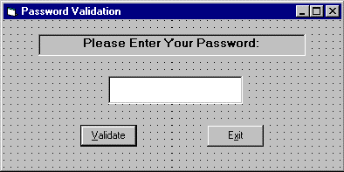
Example : Password Validation

Slide 12
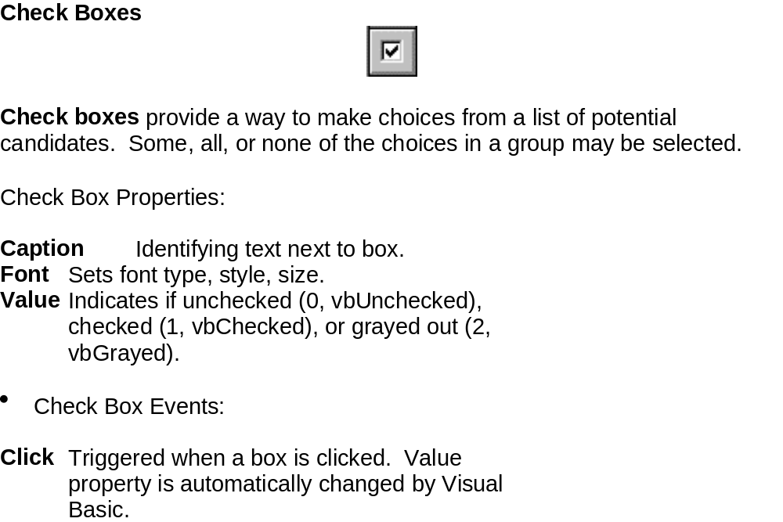
Check boxes

Slide 13
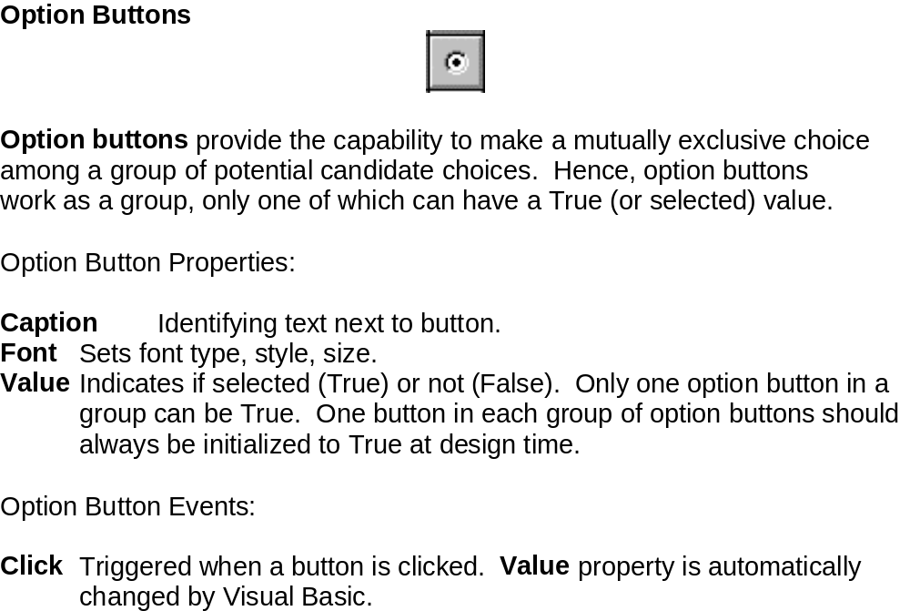
Option Buttons

Slide 14
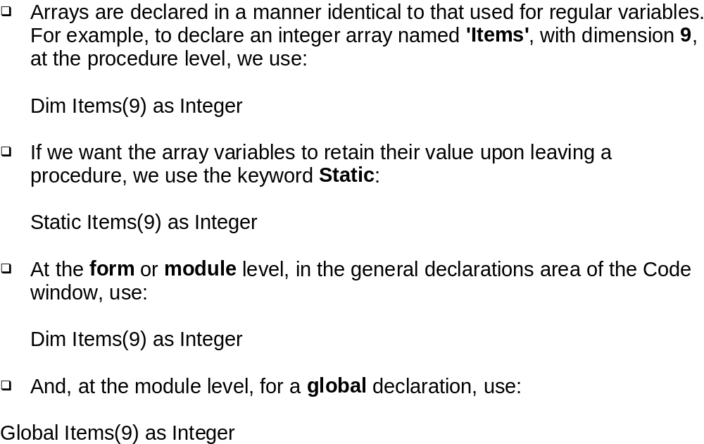
Arrays

Slide 15
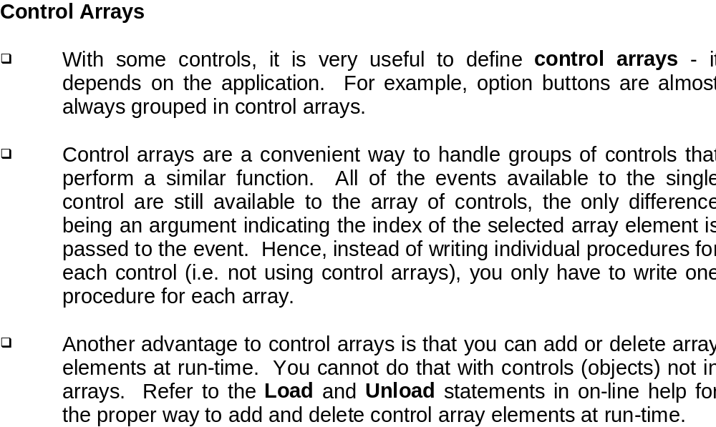
Control Arrays

Slide 16
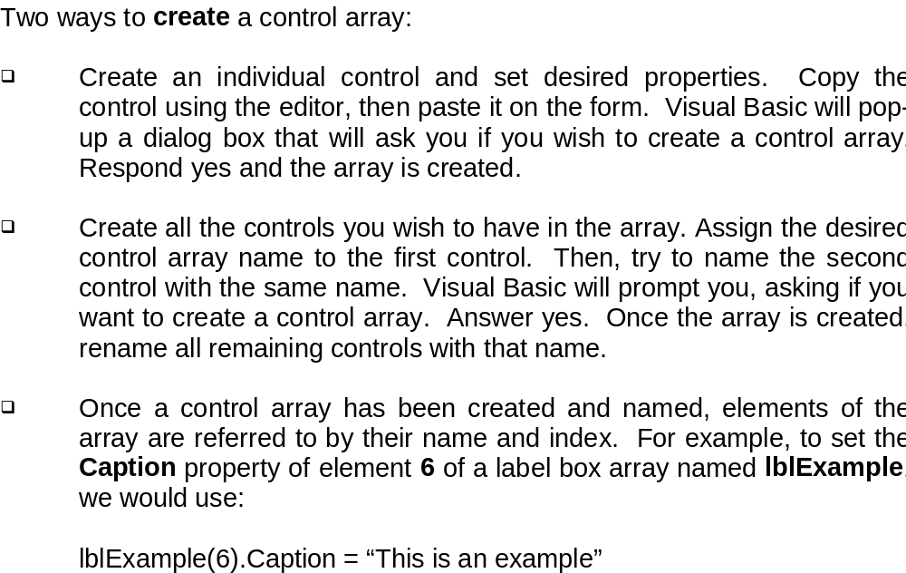
Control Arrays

Slide 17
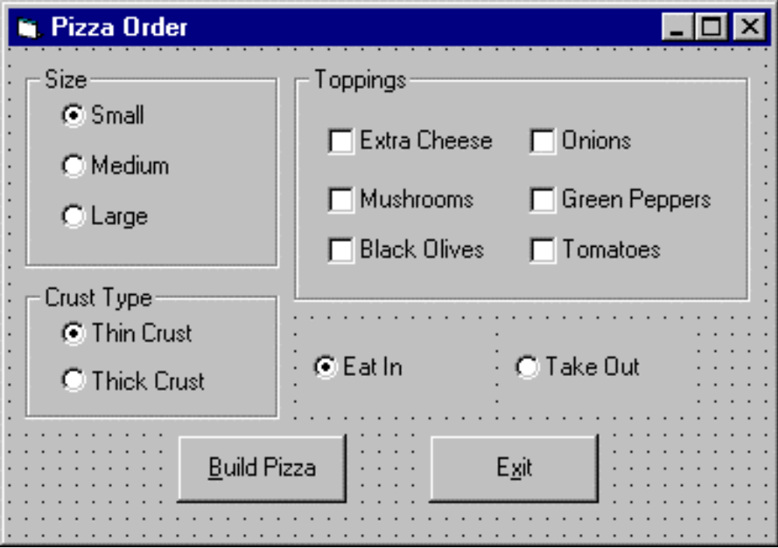
Example 2 - Pizza Order

Slide 18
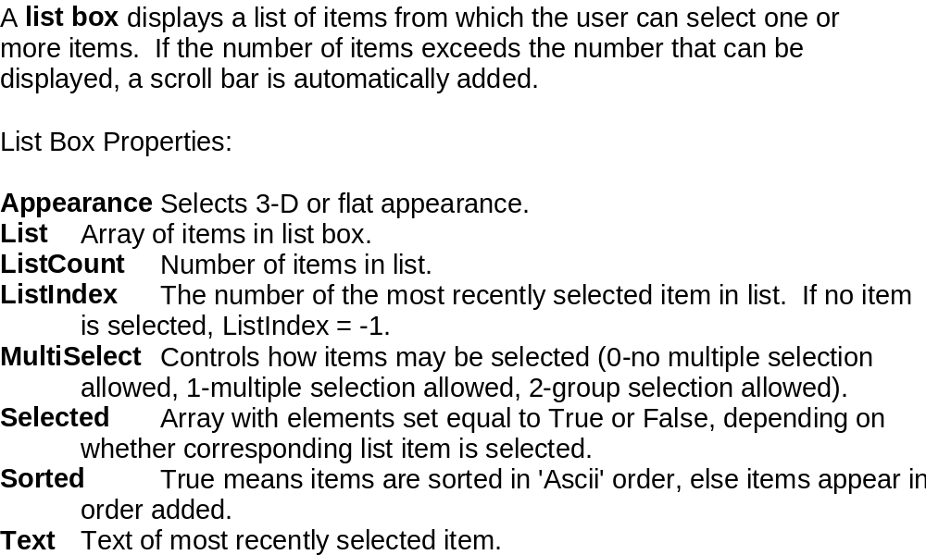
List Box

Slide 19
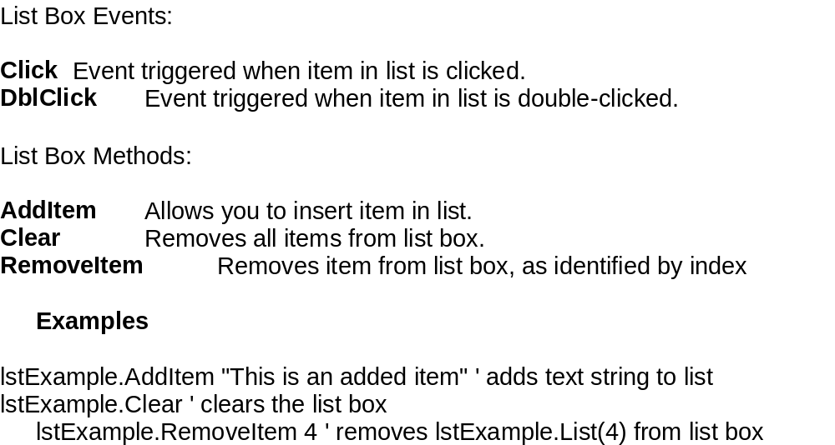
List Box

Slide 20
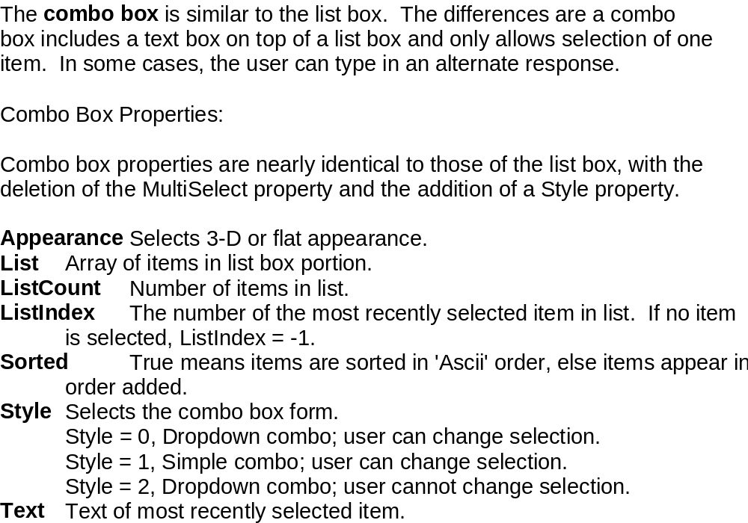
Combo Box

Slide 21
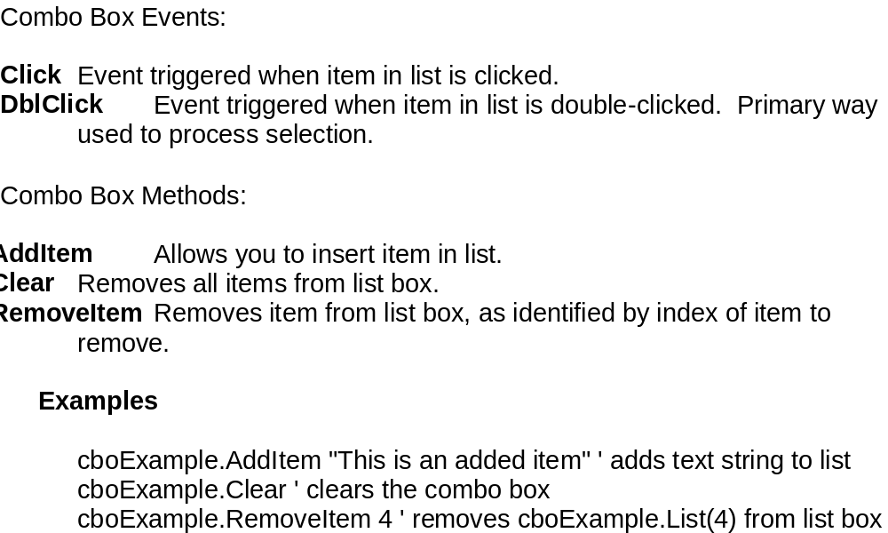
Combo Box

Slide 22
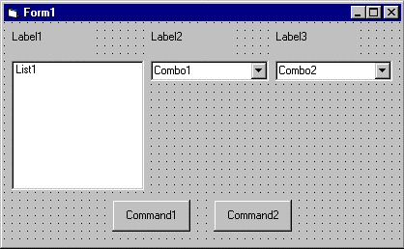
Example 3 - Flight Planner

Slide 23
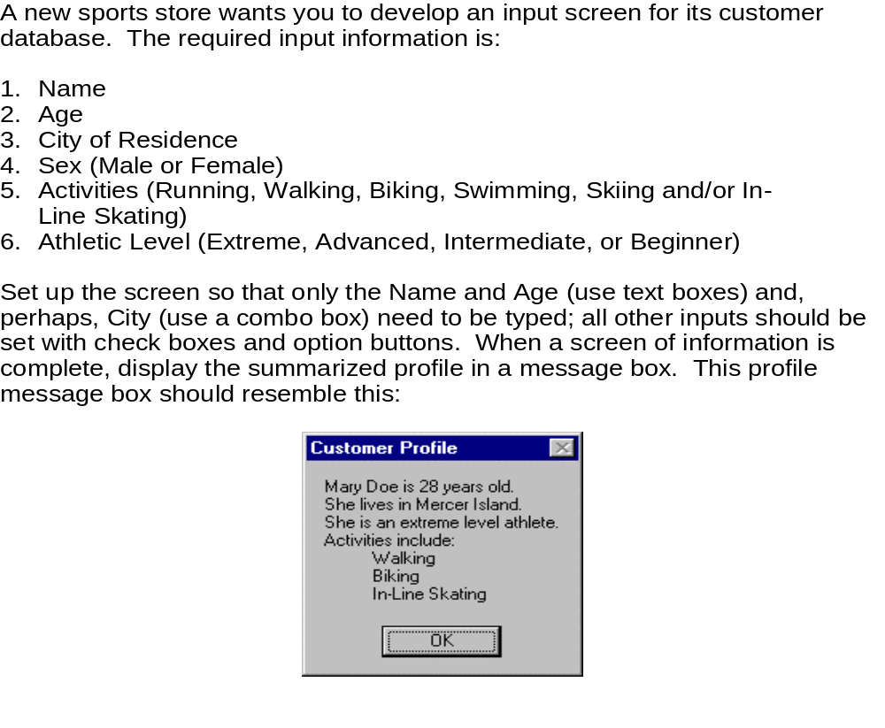
Exercise

Slide 24
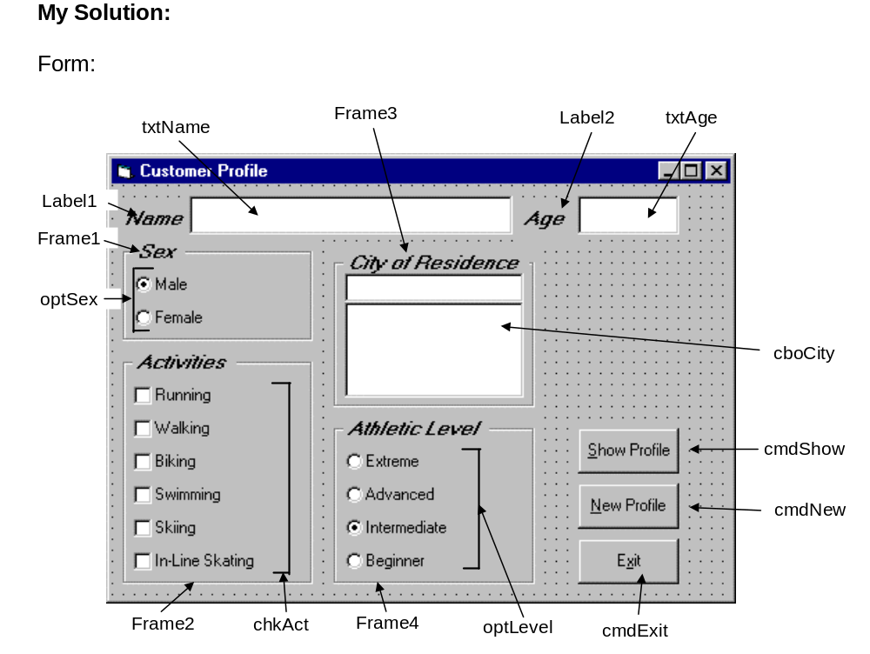

Slide 25
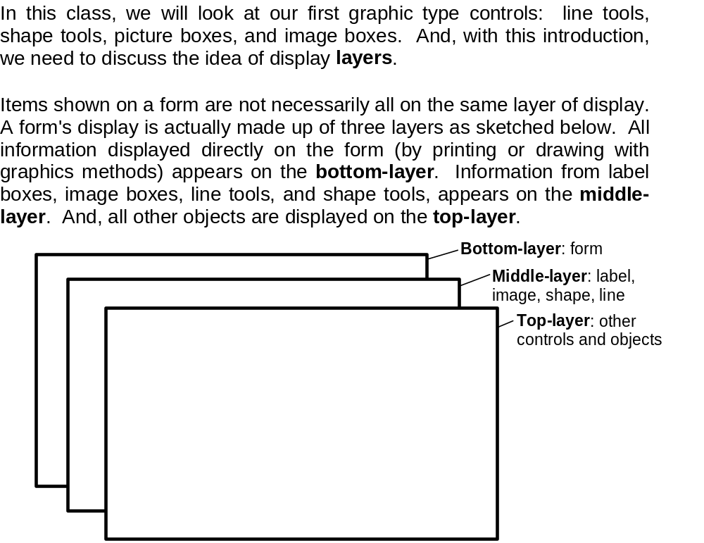
Display Layers

Slide 26
Display Layers
The next question then is what establishes the relative location of objects in the same layer. That is, say two command buttons are in the same area of a form - which one lies on top of which one? The order in which objects in the same layer overlay each other is called the Z-order. This order is first established when you draw the form. Items drawn last lie over items drawn earlier. Once drawn, however, the Z-order can be modified by clicking on the desired object and choosing Bring to Front from Visual Basic's Edit menu. The Send to Back command has the opposite effect. Note these two commands only work within a layer; middle-layer objects will always appear behind top-layer objects and lower layer objects will always appear behind middle-layer objects.

Slide 27
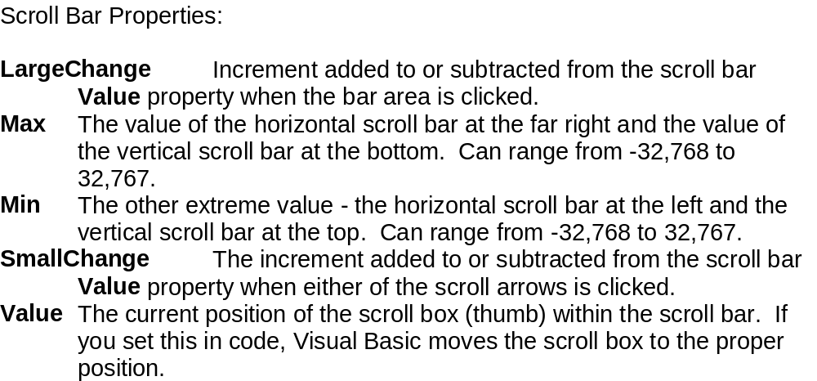
Horizontal and Vertical Scroll Bars

Slide 28
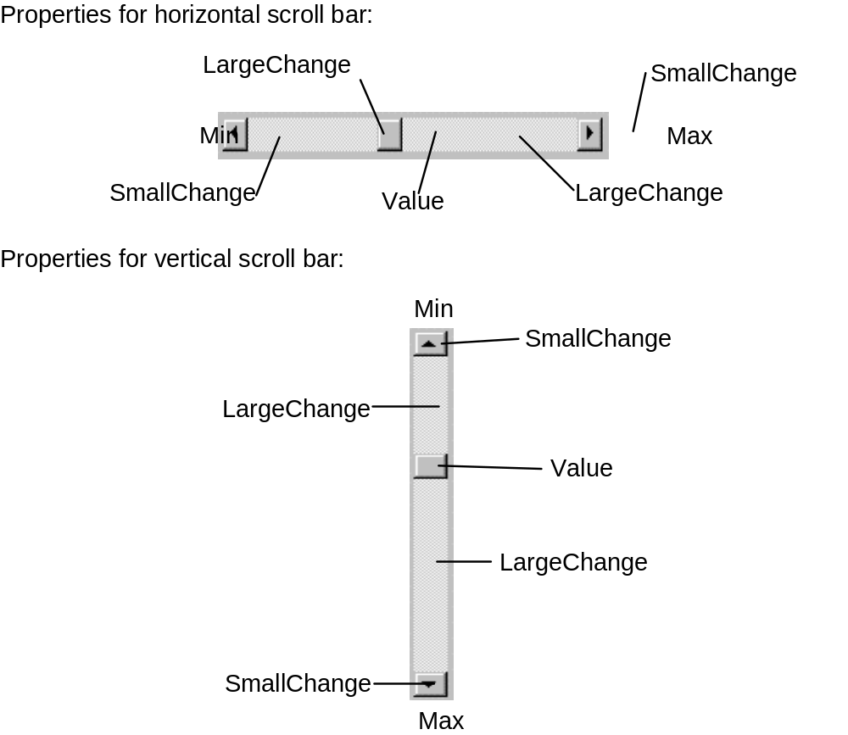
Horizontal and Vertical Scroll Bars

Slide 29
Horizontal and Vertical Scroll Bars
Scroll Bar Events:
Change Event is triggered after the scroll box's position has been modified. Use this event to retrieve the Value property after any changes in the scroll bar.
Scroll Event triggered continuously whenever the scroll box is being moved.

Slide 30
Example
Temperature Conversion Application Specifications
The application should have a scroll bar which adjusts temperature in degrees Fahrenheit from some reasonable minimum to some maximum. As the user changes the scroll bar value, both the Fahrenheit temperature and Celsius temperature (you have to calculate this) in integer format should be displayed. The formula for converting Fahrenheit (F) to Celsius (C) is:
      C = (F - 32)*5/9
To convert this number to a rounded integer, use the Visual Basic CInt() function. To change numeric information to strings for display in label or text boxes, use the Str() or Format() function. Try to build as much of the application as possible before looking at my approach. Try incorporating lines and shapes into your application if you can.

Slide 31
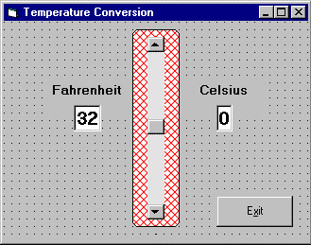
Example

Slide 32
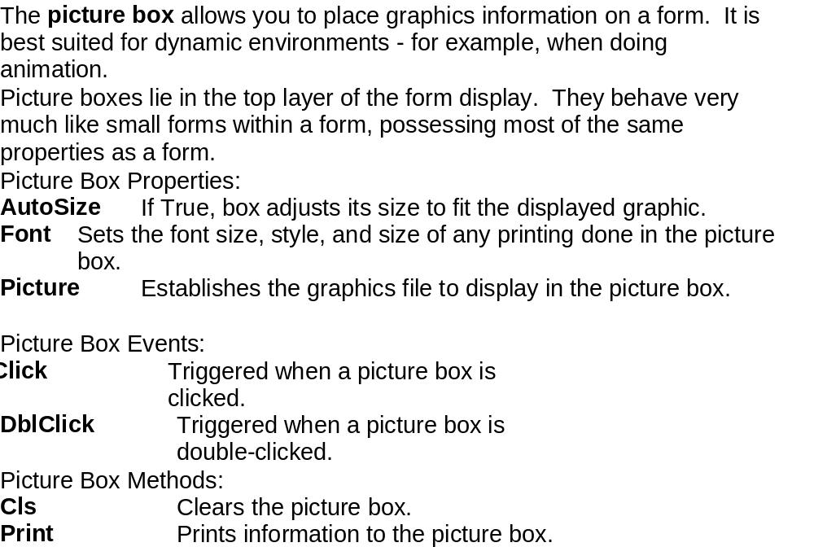
Picture Box

Slide 33
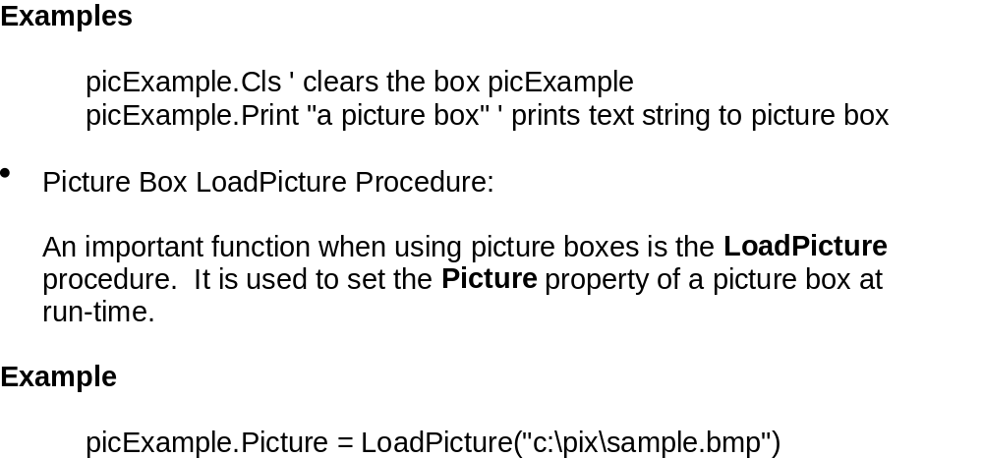
Picture Box

Slide 34
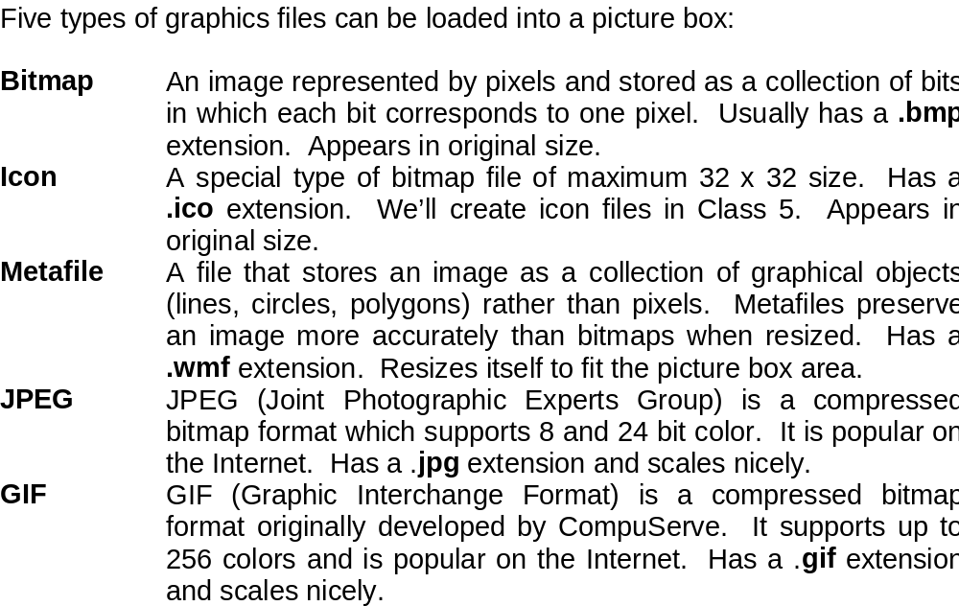
Picture Box

Slide 35
Image Viewer
Develop an application where the user can search and find graphics files (*.ico, *.bmp, *.wmf) on his/her computer. Once a file is selected, print the corresponding file name on the form and display the graphic file in an image box using the LoadPicture() function

Slide 36
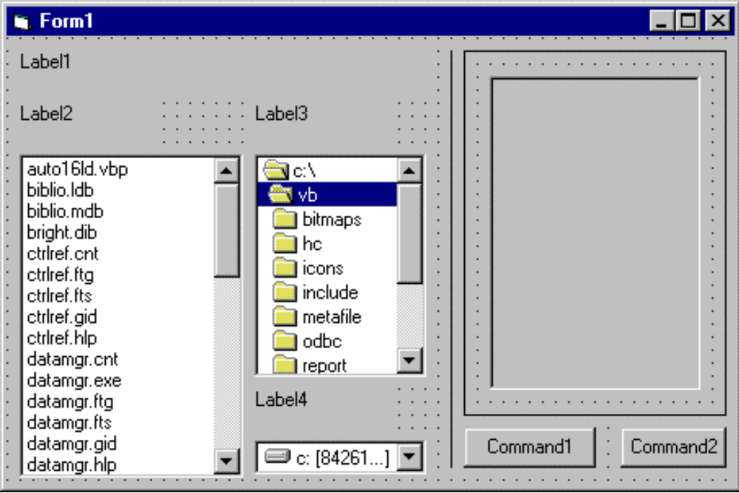
Image Viewer

Slide 37
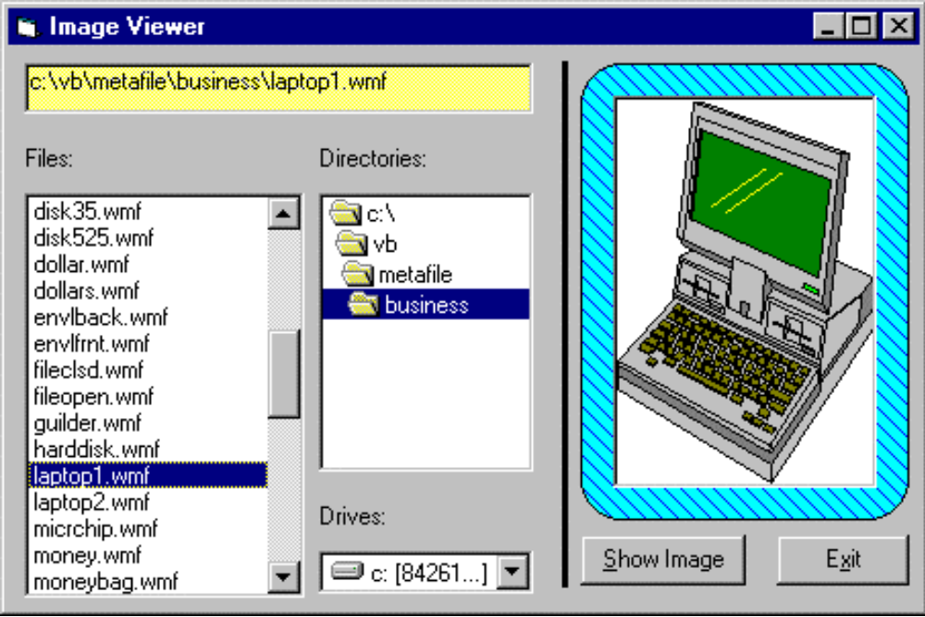
Image Viewer

Slide 38
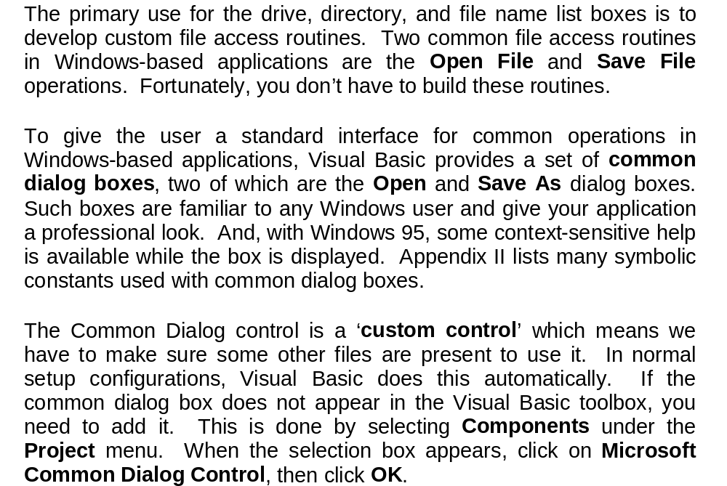
Common Dialog Boxes

Slide 39
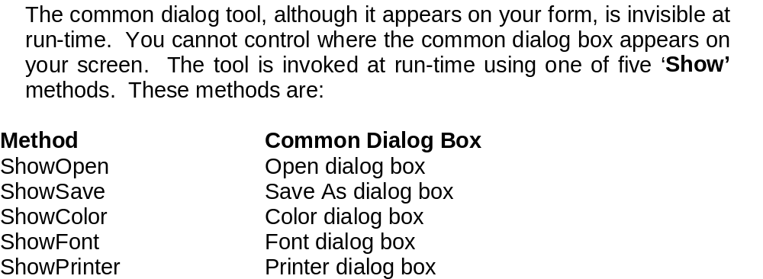
Common Dialog Boxes

Slide 40
Windows Dialog Boxes
Open Dialog Box
Save As Dialog Box
Print Dialog Box
Color Dialog Box
Font Dialog Box

Slide 41
Common Dialog Control
CommonDialogName.Method
Where
CommonDialogName is the name property assigned to the
common dialog control
Method is one of the following:
ShowOpen displays the Open dialog box
ShowSave displays the Save As dialog box
ShowColor displays the Color dialog box
ShowFont display the Font dialog box
ShowPrinter displays the Print dialog box
ShowHelp starts the Windows Help engine

Slide 42
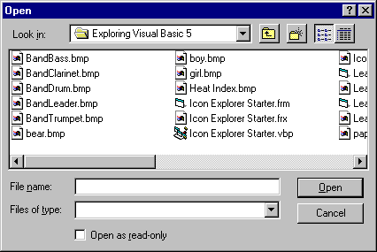
Open Dialog Box
Common Dialog control
ShowOpen method

Slide 43

Save As Dialog Box
Common Dialog control
ShowSave method

Slide 44
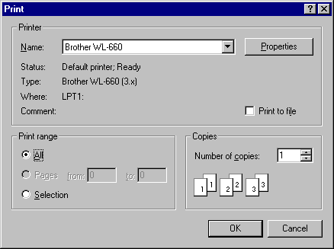
Print Dialog Box
Common Dialog control
ShowPrinter method

Slide 45
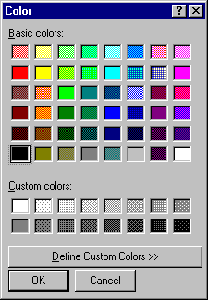
Color Dialog Box
Common Dialog control
ShowColor method

Slide 46
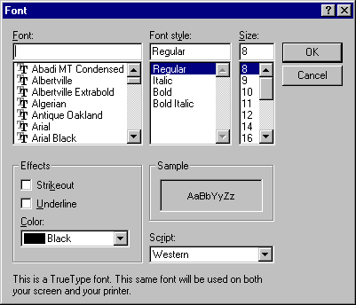
Font Dialog Box
Common Dialog control
ShowFont method

Slide 47
The Common Dialog Control
Common dialog control provides access to Windows’ most commonly used dialog boxes
First add the Common dialog ActiveX control to the toolbox
Filter property
  selects the files to display based on file extensions
  Example:
  “Text file (*.txt) | *.txt”

Slide 48
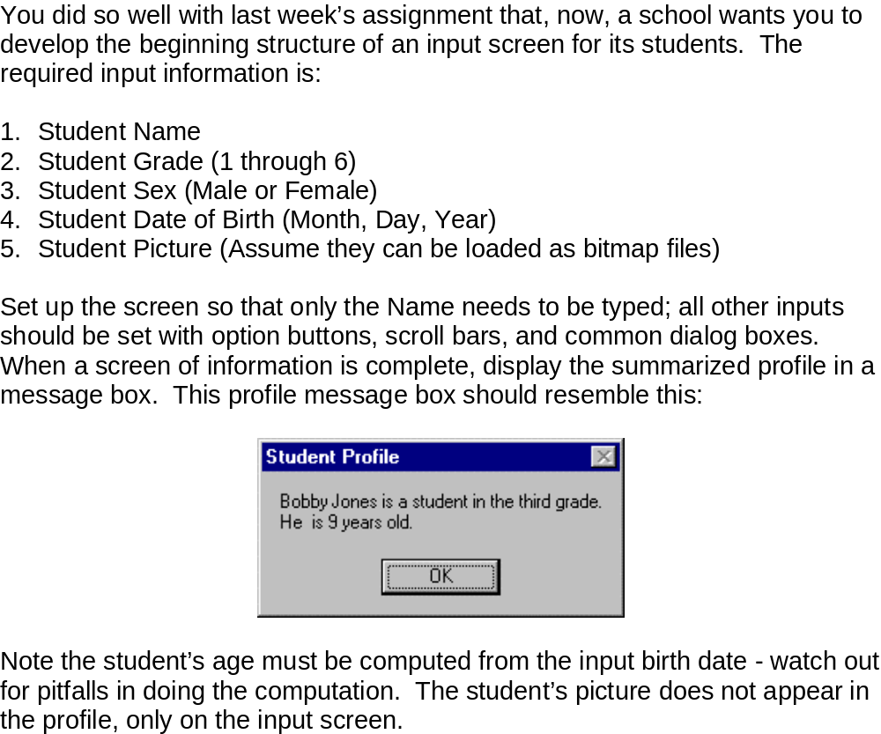
Example

Slide 49
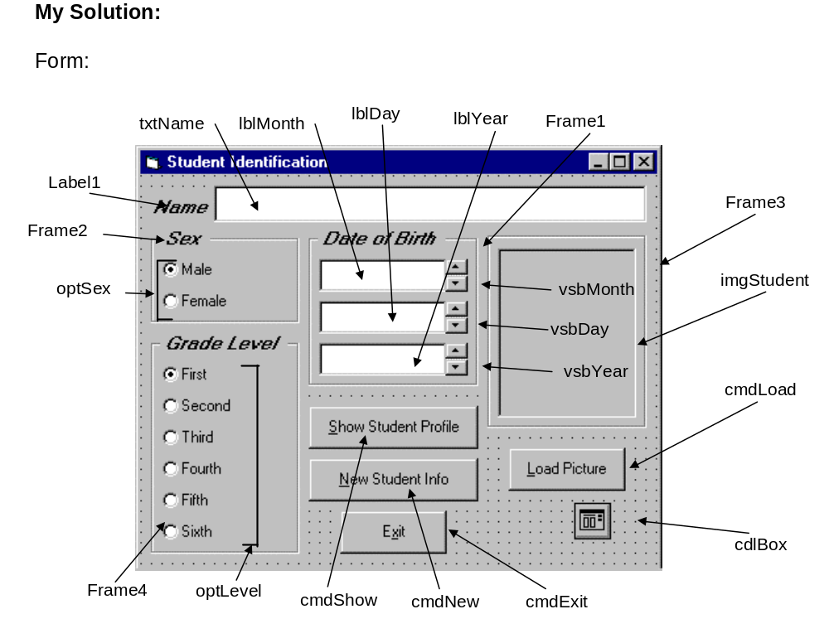
Example

Slide 50
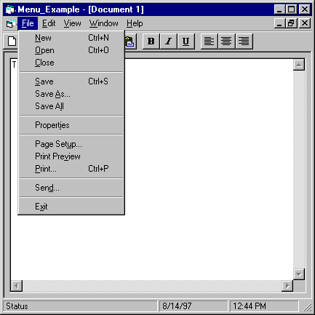
Elements of a Menu
Menu bar
Menu title
Menu items
Separator bar

Slide 51
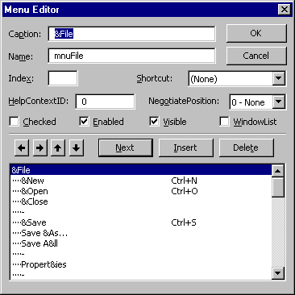
The Menu Editor
Menu control properties
Menu title
Menu control list box
Menu items
Separator bar

Slide 52
Setting Properties for
Menu Commands
Name property - assigns the name used to refer to the menu control in your code
Enabled property - menu control appears dimmed (grayed out) when not enabled
Caption property - assigns the command to display on the menu bar or submenus

Slide 53
Menus and the Menu Editor
Access key - underlined keyboard alternative to a menu command - Press Alt + key
Shortcut key - assigned to most frequently used menu items -
Press Ctrl + key
Separator Bar - divides menu items into logical groupings

Slide 54
Menu Design
Use short menu names, single word
Use unique menu items for each menu
Group menus logically
Choose a logical access key for menu items
Choose logical keyboard shortcuts for most commonly used commands

Slide 55
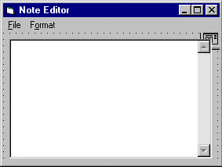
Example

Slide 56
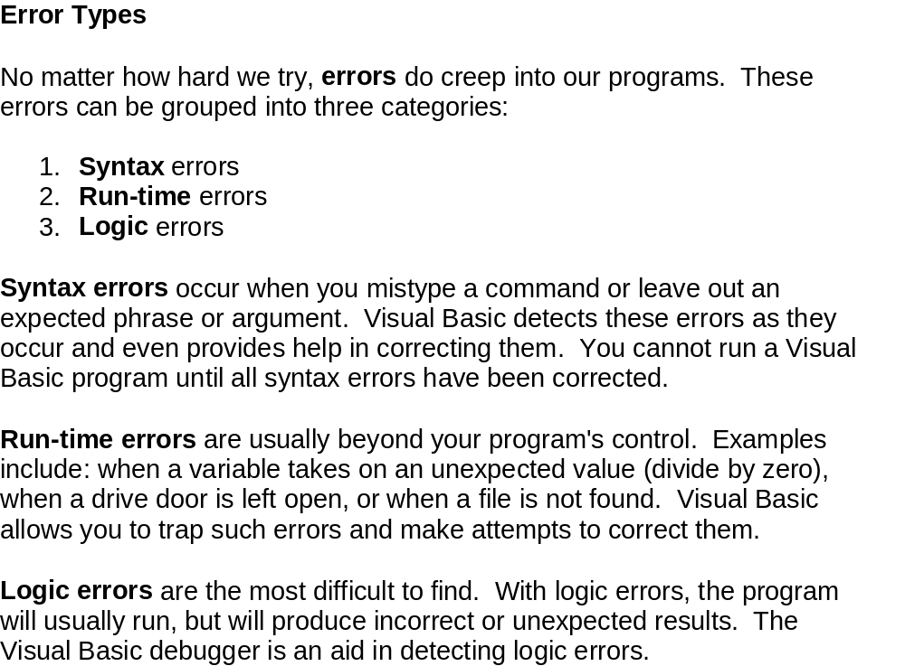
Errors

Slide 57
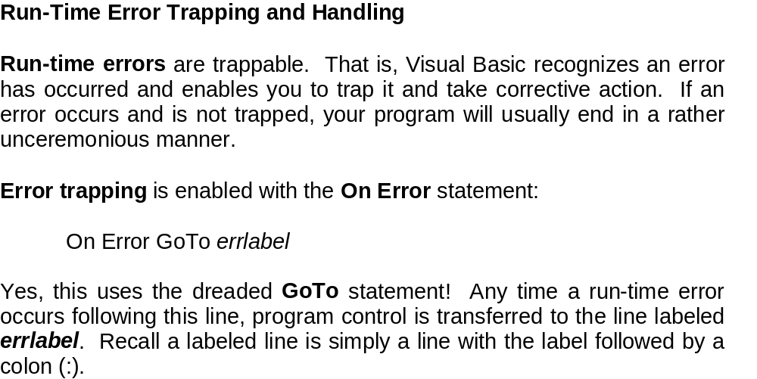
Errors

Slide 58
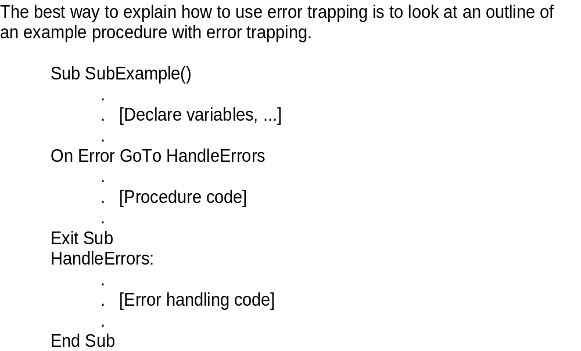
Errors

Slide 59
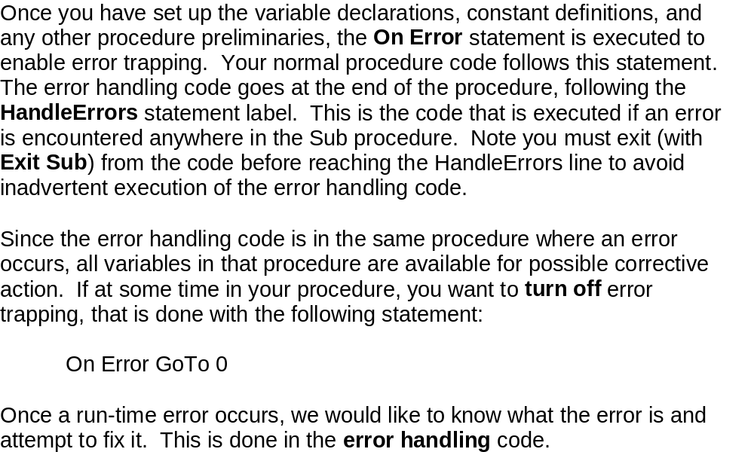
Errors

Slide 60
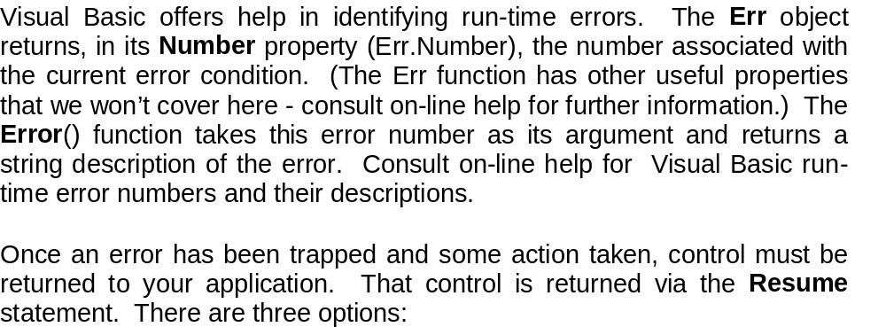
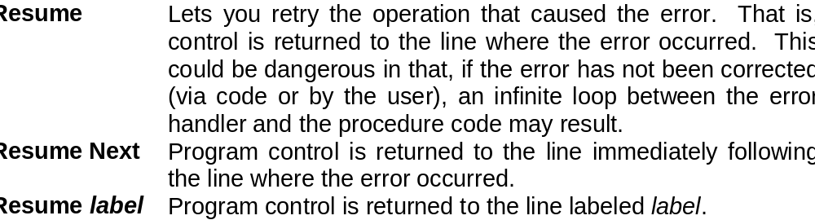
Errors

Slide 61
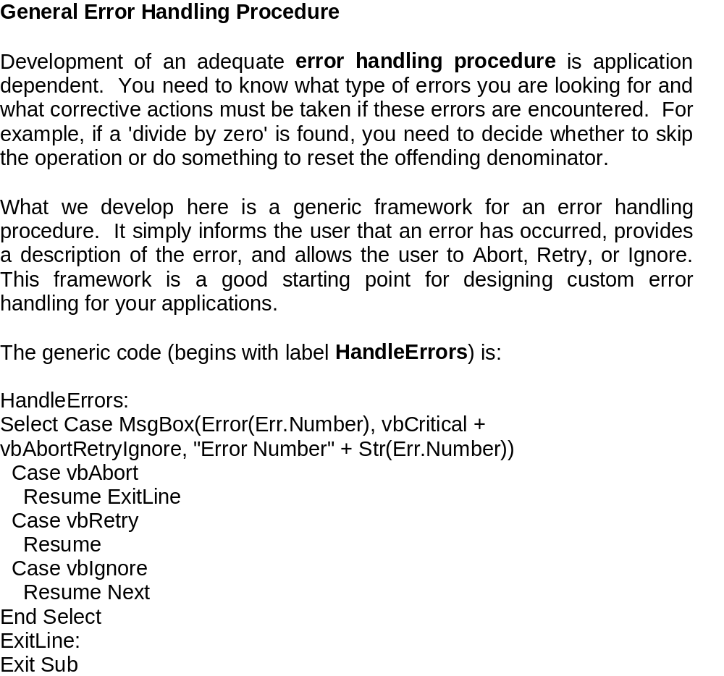
Errors

Slide 62
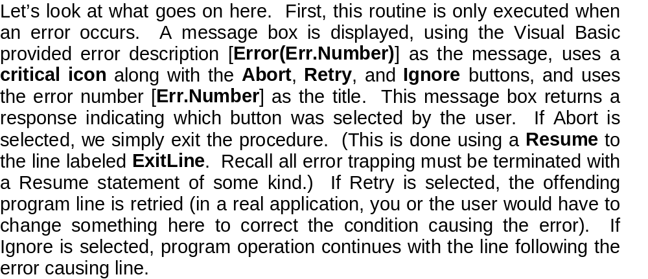
Errors

Slide 63
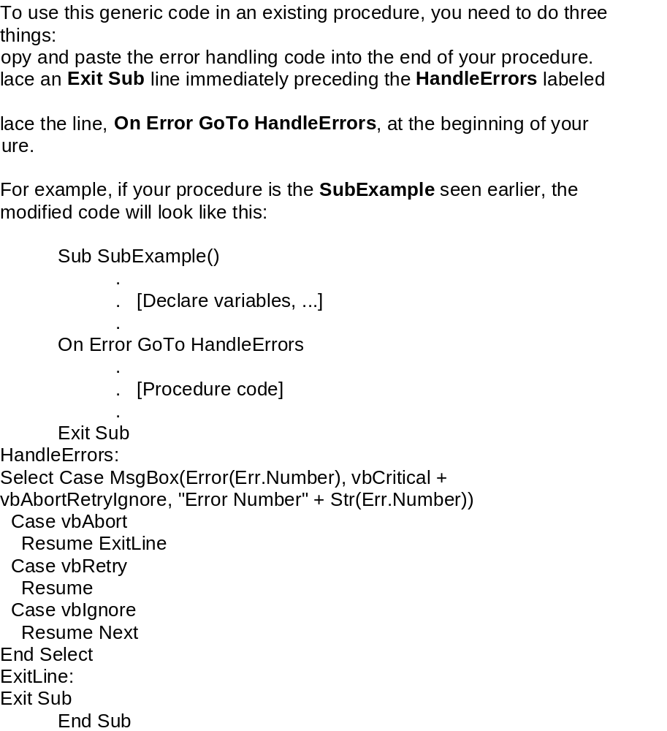
Errors

Slide 64
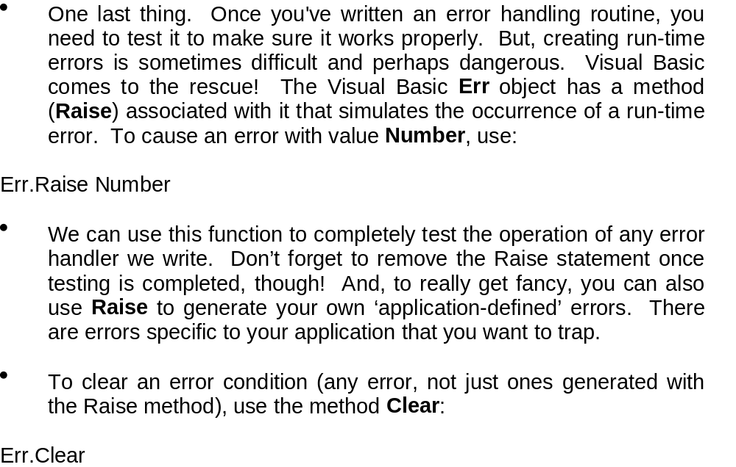
Errors

Slide 65
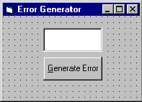
Example - Simple Error Trapping
In this example, we simply generate an error using the number input in the text box. The generic error handler then displays a message box which you can respond to in one of three ways.

Slide 66
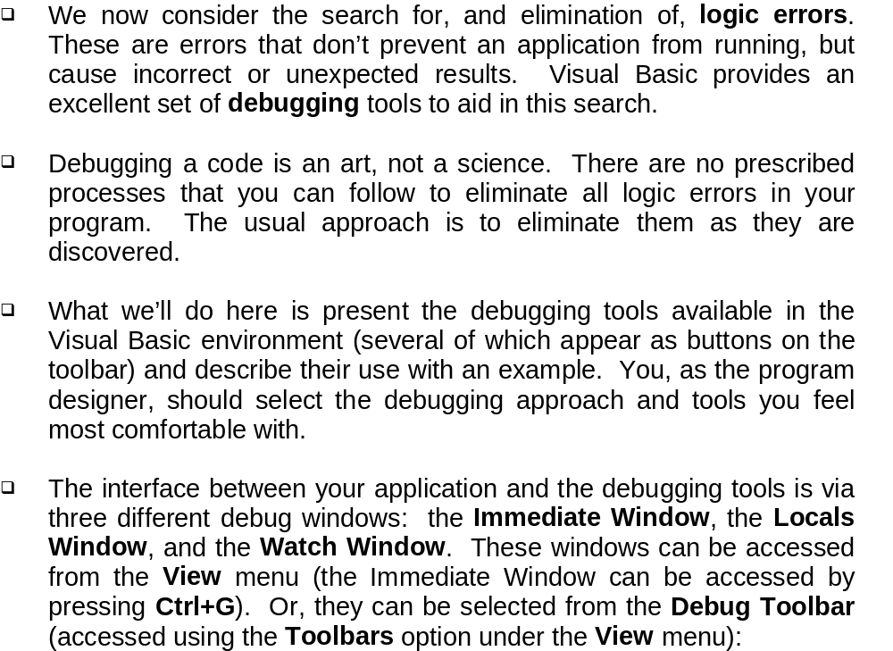
Debugging Visual Basic Programs

Slide 67

Debugging Visual Basic Programs

Slide 68

Debugging Example

Slide 69
Types of Files
File - block of information stored on disk or another media
Text file - file that contains lines of written information that can be sent directly to the screen or printer
Binary file - file that contains bits that do not necessarily represent printable text Examples: Word file, machine language file

Slide 70
Types of Files
RTF file (Rich Text Format) - standard developed by Microsoft to format documents
HTML (Hypertext Markup Language) - used to define formatting for web page files
Note: Rich Text Box control is only available in the Professional and Enterprise editions

Slide 71
File Access Methods
I/O (Input/Output) - refers to an operation or program that enters or extracts data from a computer
Access - read data from or write data to a storage device

Slide 72
File Access
Sequential access - used to read and write text files in continuous blocks
Random access - used to read and write text or binary files structured as fixed-length records
Binary access - used to read and write files that are structured according to an application’s specifications

Slide 73
Reading and Writing Files
Statements and Functions
Open statement
Input function
Input # statement
Close statement
LOF (Length of File) function
Print # statement

Slide 74
The Open Statement
Open pathname For mode As #filenumber
Where
pathname is a string that specifies a filename, and may
include the folder and drive
mode must be one of the following:
Append, Binary, Input, Output, or Random
filenumber is a valid file number from 1 to 511
Note: The FreeFile function is used to obtain the next
available file number
Example:
Open Filename For Input As #1

Slide 75
The Close Statement
Close #filenumber
Where
filenumber is any valid file number. If the file
number is omitted all active files are closed.
Example:
Close #1

Slide 76
The LOF Function
LOF(filenumber)
Where
Filenumber is a valid file number
Example:
FileLength = LOF(1)

Slide 77
The Input Function
Input(charnumber, filenumber)
Where
Charnumber is the number of characters to read
Filenumber is any valid file number
Example:
String = Input(Number, 1)

Slide 78
The Print # Statement
Print #filenumber, outputname
Where
filenumber is any valid file number
outputname is the object to be printed
Example:
Print #1, txtNote

Slide 79
Open, Read and Write a File
Sub FileIO()
Dim Pathname as String
Dim FileLength As long
Open Pathname For Input As #1
FileLength = LOF(1)
txtFile = Input(Filelength, 1)
Close #1
‘Do other stuff here
Open Pathname For Output As #1
Print #1, txtNote
Close #1
End Sub

Slide 80
Private Sub Form_Load()
Dim A As Integer, B As String, C As Single, D As Integer
A = 5
B = "Visual Basic"
C = 2.15
D = -20
Open "Test1.Txt" For Output As #1
Open "Test2.Txt" For Output As #2
Write #1, A, B, C
Write #1, D
Print #2, A, B, C
Print #2, D
Close 1
Close 2
End Sub

Slide 81
Private Sub Form_Load()
Dim A As Integer, B As String, C As Single, D As Integer
Open "Test1.Txt" For Input As #1
Input #1, A, B, C
Debug.Print "A="; A
Debug.Print "B="; B
Debug.Print "C="; C
Input #1, D
Debug.Print "D="; D
Close 1
End Sub

Slide 82

Random Access Files

Slide 83
The File System Object
FSO - new feature of Visual Basic 6.0
Provides and object based model for working with drives, folders, and files
  FileSystemObject object - primary object
  Drive object - info about a drive such as space
  Folder object - create, change, move and delete
  Files object - create, delete, change and move
  TextStream object - enables you to read and write text file

Slide 84
The File System Object
Useful Functions and Methods
  CreateObject function
  OpenTextFile method
  TextStream object methods and properties

Slide 85
FSO Example Code
Sub OpenTextFile()
Const ForReading = 1
Const ForWriting = 2
Const ForAppending = 3
Dim fso ‘File System Object
Dim textfile ‘textstream file
Set fso = CreateObject(“Scripting.FileSystemObject”)
Set textfile = fso.OpenTextFile(“C;\testfile.txt”,_
ForWriting, True, TristateFalse)
textfile.Write “This is a test.”
textfile.Close
End Sub

Slide 86
Handling I/O Errors
Bug - mistake in a computer program
Compiler errors - occur when the rules of the Visual Basic programming language were not followed
Runtime errors - occur when executing a program
Logic errors - occur when the program makes a mistake in understanding the problem or implements solution incorrectly

Slide 87
Handing I/O Errors
On Error GoTo LineName
  must be the first executable statement in a procedure
  If error is encountered, the program will execute the code immediately after the LineName statement
  Place an Exit Sub statement immediately before LineName statement

Slide 88
Handling I/O Errors
Sub FileIO()
‘Purpose: Error handling example
Dim Pathname As String
On Error GoTo ErrorHandler ‘set up handler
‘Insert code to open, save, or print file here
‘No errors encountered here
Exit Sub
ErrorHandler:
‘Display a message box and exit procedure
MsgBox “Cannot complete file operation”
Exit Sub
End Sub

Slide 89
Working with Strings
Len (Length of String) function - finds the length of a string
InStr (In String) function - searches a string for a substring
Left function - finds the leftmost characters of a string
Right function - finds the rightmost characters of a string
Mid function - finds characters in the middle of a string

Slide 90
The Len Function
Len (string | varname)
Where
String is any valid string expression
Varname is any valid variable name
Either string or a varname is given, not both
Example:
If Len(Filename) = 0 Then Exit Sub

Slide 91
The InStr Function
InStr(startposition, string, substring)
Where
startposition sets the starting position for the
search
string is the string you are searching
substring is the substring you are looking for
Example:
Position = InStr(Pathname, “\”)

Slide 92
The Left Function
Left(string, length)
Where
string is any valid string expression
length indicates the number of characters
to return
Example:
FirstEight = Left(string, 8)

Slide 93
The Right Function
Right(string, length)
Where
string is any valid string expression
length indicates the number of characters
to return
Example:
LastEight = Right(string, 8)

Slide 94
The Mid Function
Mid(string, startposition, length)
Where
string is any valid string expression
startposition sets the starting position for
extracting the substring
length indicates the number of characters
to return
Example:
MiddleWord = Mid(string, start, 6)

